Slide 1

Grocery Delivery Website
Task -2

Slide 2
Grocery Delivery Website
LMS Username | Name | Batch
Lokeshwari A | Lokeshwari A | CA9
R Sonali | R Sonali | CA9
V.Lakshmi Prasanthi | V.Lakshmi Prasanthi | CA9

Slide 3
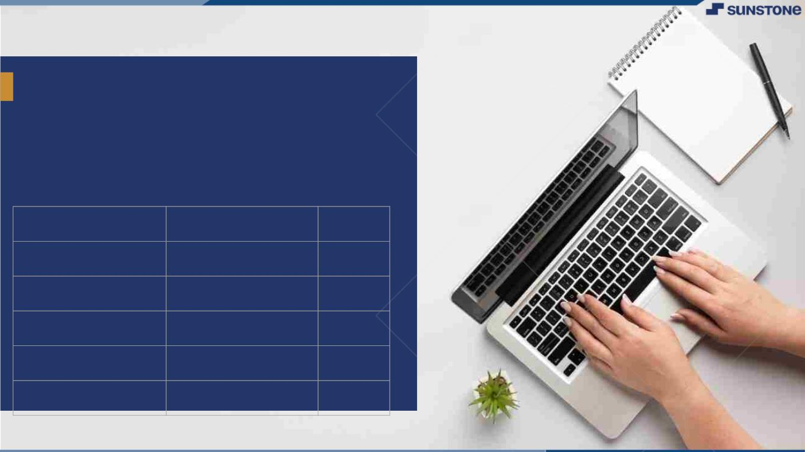
Grocery Delivery Website
This Software Requirements Specification (SRS)outlines the requirements for a Grocery Delivery website developed with HTML, CSS, and JavaScript, designed to purchase the grocery products through the website.
LMS Username
Name
Batch

Slide 4

1. Introduction
1.1 Purpose
The purpose of this document is to define the software requirements for the development of a Grocery Delivery website. This website will showcase the products and the products information using HTML, CSS, and JavaScript.
1.2 Scope
A grocery delivery website facilitates seamless online shopping, offering a user-friendly interface, extensive product listings, secure transactions, and efficient delivery logistics, enhancing customer convenience and satisfaction.
1.3 Definitions, Acronyms, and Abbreviations
HTML: Hypertext Markup Language
CSS: Cascading Style Sheets
JavaScript: A programming language for web development

Slide 5
2. Functional Requirements
2.1 Grocery Content Management
2.1.1 Choosing Products
Users can choose the required products and they can add to cart for their purchase.
2.1.2 Purchase Products
Users can purchase their products through contacting by giving the required details of the user.
2.2 Grocery Presentation
2.2.1 Home Page
The home page will display cart and login bars and provide navigation to other sections.
2.2.2 Products Page
The products page will showcase the variety of products with the respective prices.

Slide 6
2.4.3 Contact Page
The contact page will allow visitors to order products through a contact form.
2.5 Interactive Features
2.5.1 Real-Time Search and Filters
Users can dynamically search for specific products and apply filters in real-time, streamlining the shopping process.
2.5.2 Dynamic Shopping Cart Updates
An interactive shopping cart that updates in real time as users add or remove items, providing a clear overview of selected products, quantities, and total costs.
3. System Constraints
The website will be developed using HTML5, CSS3, and JavaScript.
Hosting and server requirements will be determined based on the chosen hosting platform.

Slide 7
4. Non-Functional Requirements
4.1 Performance
Provides fast and reliable service, with quick page loading times, seamless transactions, and efficient real-time updates on orders and delivery status.
4.2 Security
Data encryption, secure payment gateways, access controls, and compliance with regulatory standards, safeguarding customer information and transactions.
4.3 Compatibility
The website shall be compatible with major web browsers, including Chrome, Firefox, Safari, and Edge.
4.4 Usability
The website shall be user-friendly and easy to navigate.

Slide 8
5. Conclusion
This Software Requirements Specification (SRS) document outlines the functional and non-functional requirements for the development of a Grocery Delivery website using HTML, CSS, and JavaScript. It provides customer with a convenient and efficient online shopping experience while ensuring reliability in product delivery and data security.

Slide 9
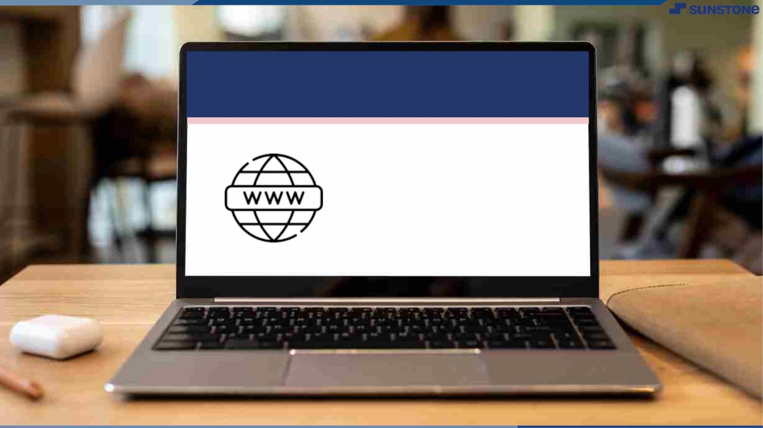
Submission Github
https://github.com/prashanthi1502/Grocery-Delivery

Slide 10


